Slide 1
U.S. History E.O.C.T
Part IV
U.S. Establishment as a World Power

Slide 2
Domain III
Standards 15 - 20
U.S. involvement in World War I
Key developments that occurred after WWI
Great Depression
The New Deal
U.S. Involvement in World War II
Impact of the Cold War on the U.S.

Slide 3
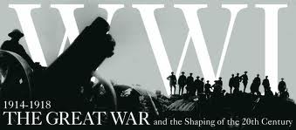
U.S. Involvement in WWI

Slide 4
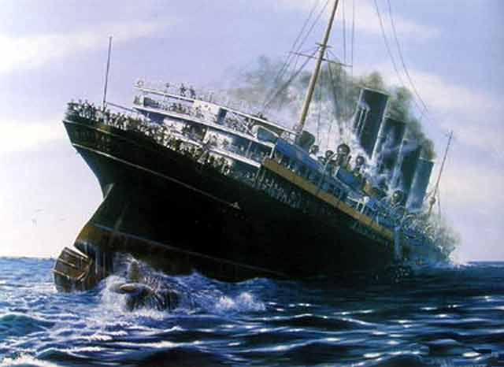
World War I - Origins 1914-1918
President Woodrow Wilson was determined to guarantee U.S. neutrality and keep the United States out of the war.
1915 the luxury liner Lusitania was sunk by a German submarine, killing most of the people onboard, including more than 100 U.S. citizens.

Slide 5
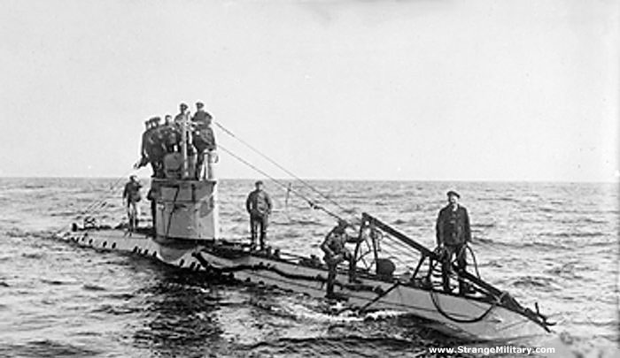
German Unterseeboot (U-Boat)
This led to crisis between the United States and Germany that was only resolved when Germany agreed to abandon unrestricted submarine warfare that endangered U.S. trade and American lives.
However, in 1917 Germany resumed unrestricted submarine warfare, creating great anti-German feelings among Americans.
This heightened tension led to the U.S. decision to enter the war.

Slide 6
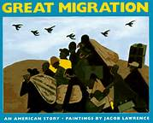
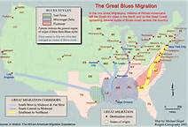
The Domestic Impact of in WWI
The war created jobs in northeastern and mid-western cities.
African Americans, tired of living under the repression that was common in the South, moved to the North by the thousands and established themselves in ethnically distinct and culturally rich neighborhoods.
This movement of African Americans was called the Great Migration.

Slide 7
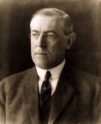
Wilson, Debs, and the Espionage Act of 1917.
During the war, laws were passed that prohibited people from speaking out against it.
The Espionage Act of 1917 made it a crime to communicate any information that would interfere with U.S. military operations or aid its enemies.
President Wilson supported this law to silence critics and pacifists.

Slide 8

Eugene V. Debs , the Socialist Party presidential candidate in 1904, 1908, and 1912, was convicted for hindering military recruiting by making a speech against it
He was sentenced to 10 years in prison.
Many people thought it violated the First Amendment.

Slide 9
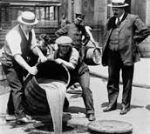
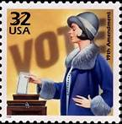
18th & 19th Amendments
Social changes seen during the war led to two constitutional amendments. Americans’ anti-German feelings led to a campaign to outlaw beer and other alcoholic beverages.
This campaign well suited the Progressive Era’s opposition to saloons.
Congress passed the 18th Amendment, which prohibited “the manufacture, sale, or transportation of intoxicating liquors.”
Ratification of the 19th Amendment, gave women the right to vote.
Helped by the country's gratitude for women’s economic contributions during WWI.

Slide 10
Isolationism
Before the United States entered the war, Wilson had given a speech in which he described Fourteen Points he felt were key to avoiding future wars.
One point called for the creation of an international peacekeeping organization called the League of Nations.

Slide 11
During the post-war treaty negotiations, Wilson worked hard to get as many as possible of his Fourteen Points included in the treaty and succeeded in securing the creation of the League of Nations.
However, American opposition to the League of Nations ultimately led the Senate to refuse to ratify the treaty.
Isolationists in the Senate believed that by joining the League the United States would become involved in future conflicts in Europe and elsewhere.
The US never joined the League.

Slide 12
Question Time
The United States responded to Germany’s unrestricted submarine warfare during the early 1900s by
A. entering World War I
B. suspending trade with Britain
C. signing a treaty with Austria-Hungary
D. withdrawing military forces from Europe

Slide 13
Answer
The United States responded to Germany’s unrestricted submarine warfare during the early 1900s by
A. entering World War I
B. suspending trade with Britain
C. signing a treaty with Austria-Hungary
D. withdrawing military forces from Europe

Slide 14
Question Time
The passage of the 18th Amendment to the U.S. Constitution in 1919 established?
A. the prohibition of alcohol.
B. the direct election of senators.
C. the right of labor unions to organize.
D. the power of voters to remove an elected official.

Slide 15
Answer
The passage of the 18th Amendment to the U.S. Constitution in 1919 established
A. the prohibition of alcohol.
B. the direct election of senators.
C. the right of labor unions to organize.
D. the power of voters to remove an elected official.

Slide 16
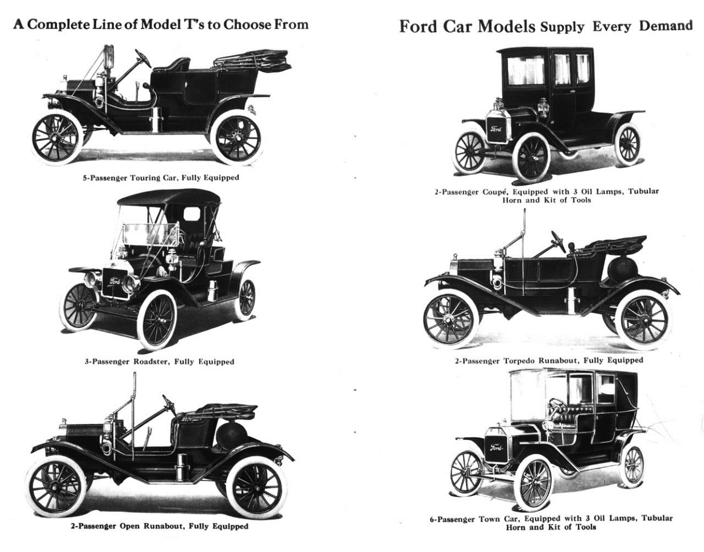
Aftermath of WW I
Standard 16

Slide 17
Communism and Socialism
In the late 1800s and early 1900s, a new political ideology called communism grew out of the more moderate socialism.
Communism was based on a single-party government ruled by a dictator.
Under communism, there is no private ownership; all property is owned by the state.

Slide 18
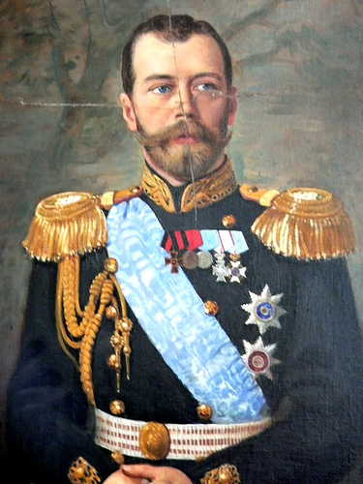
Communism and Socialism
In 1919, after communist revolutionaries known as Bolsheviks overthrew the Czar in Russia.
The Bolsheviks established the Soviet Union, and called for a worldwide revolution to destroy capitalism.
People in the United States began to fear communists.
Czar Nicholas II of
Russia 1918

Slide 19

Soviet Red Scare
This fear of international communism was called the Red Scare because red was the color of the communist flag.
This fear led to the government pursuing suspected communists and socialists.

Slide 20
Immigration Restriction
The Red Scare was one factor that led to new restrictions on immigration. Other ideas grew strong in America in the 1920s.
One of the ideas was that people born in America were superior to immigrants.
The other was that America should keep its traditional culture intact.
Ultimately, this conservative reaction against immigrants resulted in the passage of legislation that set limits on the number of immigrants who could come from each country.

Slide 21
Question Time
What was the result of the decline of immigration from Europe to the United States during World War I?
Both political parties called for the end of isolationist policies.
Legal barriers to immigration from Asian countries were removed.
Large numbers of African American workers moved north to take industrial jobs.
American industry declined because of the loss of the immigrant workforce.

Slide 22
Answer
What was the result of the decline of immigration from Europe to the United States during World War I?
Both political parties called for the end of isolationist policies.
Legal barriers to immigration from Asian countries were removed.
Large numbers of African American workers moved north to take industrial jobs.
American industry declined because of the loss of the immigrant workforce.

Slide 23

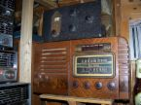
Popular Culture
During the 1920s, popular entertainment such as radio and the movies attracted millions of loyal fans and helped create the first media stars.
Conservatives often disapproved of what they viewed as the immoral influence of these forms of entertainment but were unable to reduce their popularity.

Slide 24

JAZZ
Jazz combined themes and note patterns developed by enslaved African Americans with the syncopated rhythms worked out by musicians in New Orleans and elsewhere in the South.
It was an original American art form and became very popular in the 1920s.

Slide 25
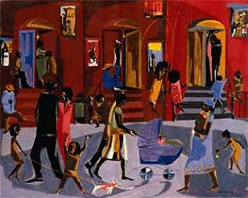
Harlem Renaissance
During the 1920s, a wave of creativity washed over Harlem, celebrating African American culture through words and song.
This is known as the Harlem Renaissance.

Slide 26
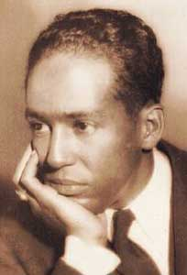
Langston Hughes
The movement’s best-known poet was Langston Hughes.
He wrote about the lives of working class African Americans and sometimes set his words to the tempo of jazz or blues.

Slide 27
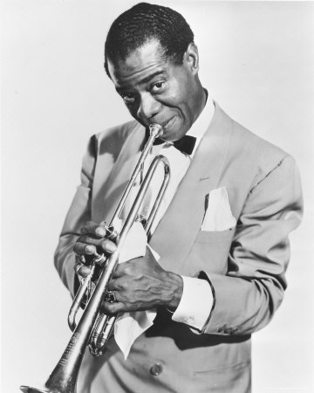
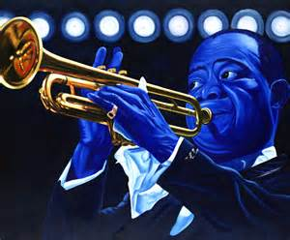
Louis Armstrong
Trumpet player Louis Armstrong, sometimes called “Satchmo,” became known while playing with the Creole Jazz Band.
Later he became one of the biggest stars of jazz music because of his sense of rhythm and his improvisational skills.

Slide 28
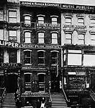
Tin Pan Alley
While the Harlem Renaissance was occurring, another musical movement, Tin Pan Alley, was also on the rise in New York City.
The name “Tin Pan Alley” is deceiving because it does not just refer to an actual place in Manhattan, but also names the group of music writers and publishers who worked there.

Slide 29
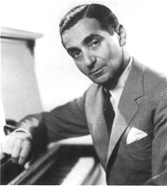
Irving Berlin
One of the most famous was Irving Berlin, who wrote hundreds of songs during his career, including “God Bless America” and “White Christmas.”

Slide 30
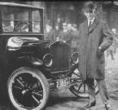
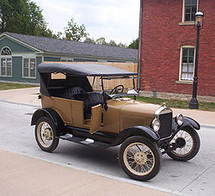
Henry Ford 1863 – 1947
A development of the 1920s was the emergence of the automobile as a true replacement for the horse, not just a plaything for the wealthy.
This was made possible by an industrial process called mass production.
This process was popularized by Henry Ford during the manufacture of his Ford Model T. The Model T was designed to cost low enough for common people to afford.

Slide 31
Question Time
What was the significance of the career of Henry Ford during the early 1900s?
He strongly influenced the early development of jazz music.
He exposed corrupt business practices as a muckraking journalist.
He founded a large labor union that favored the use of collective bargaining.
He made automobiles more affordable through new mass-production techniques.

Slide 32
Answer
What was the significance of the career of Henry Ford during the early 1900s?
He strongly influenced the early development of jazz music.
He exposed corrupt business practices as a muckraking journalist.
He founded a large labor union that favored the use of collective bargaining.
He made automobiles more affordable through new mass-production techniques.

Slide 33
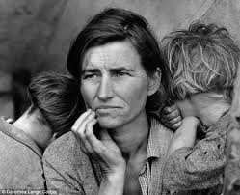
Causes and Consequences of the
Great Depression
Standard 17

Slide 34
Causes of the Great Depression
During the 1920s, the wealthy grew wealthier due in large measure to government fiscal policies that allowed them to keep more of their money and that reduced business regulations.
These reduced regulations and low corporate taxes increased the profits of corporations and made their stocks more valuable.

Slide 35
At the same time, the poor and working classes lost the ability to buy products because their wages stayed the same while prices rose.
This reduction in consumer consumption resulted in business overproduction and eventually caused business profits to decline. These factors were an important cause of the Great Depression.

Slide 36
More Problems!
New methods of buying products, including the installment plan and buying on credit, became popular during the 1920s.
These methods encouraged consumers to buy more than they could afford and to go into debt.
Worst of all, banks loaned people money to buy stock with very little money down.

Slide 37
CRASH!!!!!!
The stocks themselves became the collateral for the loan. This was called buying on margin.
Rising stock prices and the ability of ordinary people to buy stock on credit increased investment in the stock market and inflated the price of stocks above their actual value.
Then, by October 1929, the U.S. economy was beginning to show signs of slowing down.
Stockholders feared the economy was ending a period of prosperity and entering a period of recession.

Slide 38
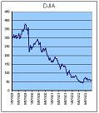
Bottom fell out!
This caused some investors to panic and sell their stocks.
As more people sold their stock, other people panicked and sold their stock as well, driving down their prices and causing a stock market crash.

Slide 39
In turn, the stock market crash triggered other economic weaknesses and plunged the United States into the Great Depression.
The Great Depression–a severe economic recession in the 1930s that affected all the world’s industrialized nations and the countries that exported raw materials to them.

Slide 40
Widespread Unemployment
As profits fell and it became clear consumers would need to reduce spending, workers began to lose their jobs.
By 1932 the unemployment rate in the U.S. had reached 25%.
Unemployed workers who had no savings could not pay their debts, and many lost their homes.
Homeless and unemployed people settled in camps of shacks and tents in rundown areas.

Slide 41
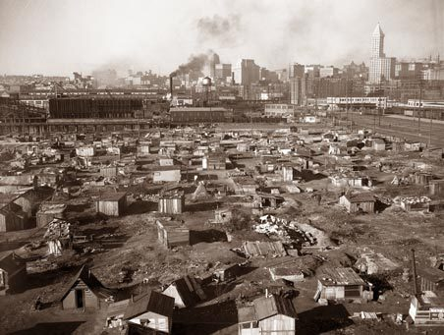
Hoovervilles
These camps became known as Hoovervilles, named after Herbert Hoover, the U.S. president when the Depression started.
These residents slept in packing crates or on the ground and begged for food.

Slide 42
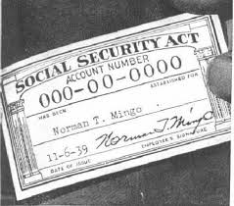
Franklin Roosevelt’s New Deal as a response to the depression
Standard 18

Slide 43
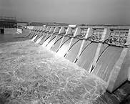
Putting People to Work
One of Roosevelt’s major New Deal programs was the Tennessee Valley Authority (TVA).
This was established in 1933 to build dams and power plants along the Tennessee River and its tributaries. The Tennessee Valley itself runs through seven states, so the project was very large.
The TVA built dozens of dams to control the environment by preventing disastrous floods.
Each dam had its own power plants, parks, and navigation aids, and their construction created hundreds of jobs for unemployed workers.

Slide 44
Second New Deal
The Second New Deal refers to the programs President Roosevelt instituted after his original New Deal failed to completely fix the American economy.
The National Labor Relations Act, better known as the Wagner Act, was one of the first reforms of Roosevelt’s Second New Deal.
This law established collective bargaining rights for workers and prohibited such unfair labor practices as intimidating workers, attempting to keep workers from organizing unions, and firing union members.
The Wagner Act also set up a government agency where workers could testify about unfair labor practices and hold elections to decide whether or not to unionize.

Slide 45
Wagner Act & AFL-CIO
After passage of the Wagner Act, industrial workers began to unionize. The American Federation of Labor (AFL) was hesitant to organize industrial unionism, because it was committed to craft-based workers such as carpenters and railroad engineers.
As a consequence, the Congress of Industrial Organizations (CIO) was created to represent industrial workers who felt they were not being represented by the AFL.
The AFL and CIO clashed on and off before merging in 1955 to become the AFL-CIO that exists today.

Slide 46
Question Time
Which development directly contributed to the increase shown in the graph?
Social Security
the Wagner Act
the Marshall Plan
the Roosevelt Corollary

Slide 47
Answer
Which development directly contributed to the increase shown in the graph?
Social Security
the Wagner Act
the Marshall Plan
the Roosevelt Corollary

Slide 48
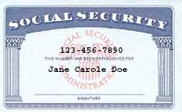
Social Security Act of 1935
One of the most important actions of the Second New Deal was the Social Security Act, which was passed in 1935.

Slide 49
S.S. Act consisted of three programs:
Old-age insurance for retirees aged 65 or older and their spouses, paid half by the employee and half by the employer.
Unemployment compensation paid by a federal tax on employers and administered by the states
Aid for the disabled and for families with dependent children paid by the federal government and administered by the states

Slide 50
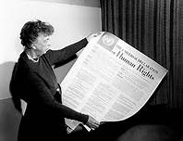
Eleanor Roosevelt
President Roosevelt’s wife Eleanor, was very influential in her own right.
She was interested in humanitarian causes and social progress.
She was a supporter of women’s activism.
Influential in convincing Roosevelt to appoint more women to government positions.

Slide 51
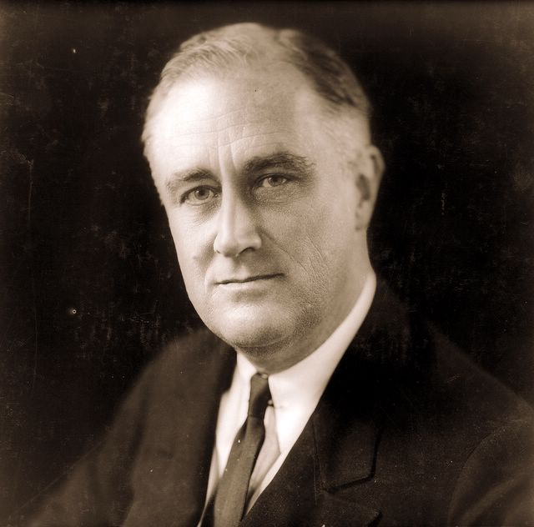
Franklin Delano Roosevelt “FDR”

Slide 52
Roosevelt’s Political Challenges
During his 12-year presidency, President Roosevelt faced many challenges to his leadership, and many critics.
Opponents of the New Deal came from all parts of the political spectrum.
Some conservatives thought he had made the federal government too large and too powerful and that it did not respect the rights of individuals and property.
Some liberals thought he had not gone far enough to socialize the economy and eliminate inequality in America.

Slide 53
Neutrality Acts
In Europe, WWII started long before America entered it.
To prevent Roosevelt from involving America in what many viewed a European war, Congress passed a series of Neutrality Acts to make it illegal to sell arms or make loans to nations at war.
In recognition of the Nazi threat to Western Europe’s democracies, part of the act permitted the sale of arms o nations at war on a “cash & carry” basis.
This meant that buyers would have to pay cash and send their own ships to American ports to pick up supplies.
This kept American ship from being sunk by the Germans.

Slide 54
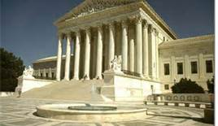
Court-packing Bill
The Court-packing Bill was a law Roosevelt proposed to give presidents the power to appoint an extra Supreme Court justice for every sitting justice over the age of 70 ½ .
He planned to use this bill’s power to add more of his supporters to the Supreme Court to uphold the New Deal programs.
The version of the law passed by Congress weakened the power he desired.

Slide 55
Questions Again
Why did Congress pass the Wagner Act of 1935?
A. to provide electricity and flood control
B. to protect the rights of organized labor
C. to offer social services to elderly citizens
D. to limit U.S. intervention in foreign conflicts

Slide 56
Answer
Why did Congress pass the Wagner Act of 1935?
A. to provide electricity and flood control
B. to protect the rights of organized labor
C. to offer social services to elderly citizens
D. to limit U.S. intervention in foreign conflicts

Slide 57
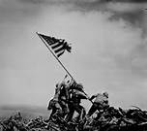
Impact of World War II
&
Growth of the Federal Government
Standard 19

Slide 58
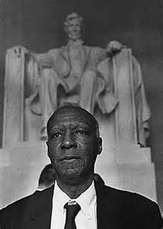
Protesting Discrimination
1941, A. Philip Randolph, founder of the Brotherhood of Sleeping Car Porters, proposed a march on Washington D.C.
The march was to protest discrimination in the military and in industry.
Roosevelt, afraid the march might
cause unrest among whites, summoned
Randolph to the White House to ask
him to call off the march.

Slide 59
Randolph refused.
As a result of Randolph’s refusal, Roosevelt issued an executive order that called on employers and labor unions to cease (end) discrimination in hiring practices in industries related to defense.

Slide 60
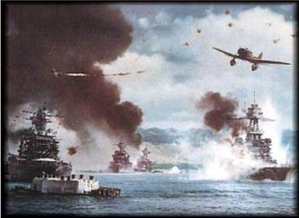
Pearl Harbor & Its Aftermath
On the morning of December 7, 1941, the navy of the Empire of Japan launched a surprise attack on the U.S. Navy base at Pearl Harbor, Hawaii.
Over 2,403 Americans were killed and 1,178 more were wounded, 21 ships were damaged, and 300 aircraft were destroyed.
The Japanese attack took the United States officially into World War II.

Slide 61
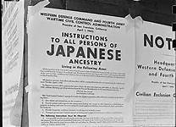
Fear Grips America
One effect of America’s entry into the war was alarm about the loyalty of Japanese Americans: 120,000 Japanese Americans lived in the United States, most of them on the West Coast.
Fears of spies and sabotage led to prejudice and sometimes violence against Japanese Americans.
In the name of national security, Roosevelt ordered all people of Japanese ancestry be moved from California and parts of Washington, Oregon, and Arizona to rural prison camps.

Slide 62
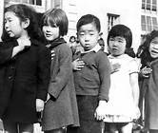
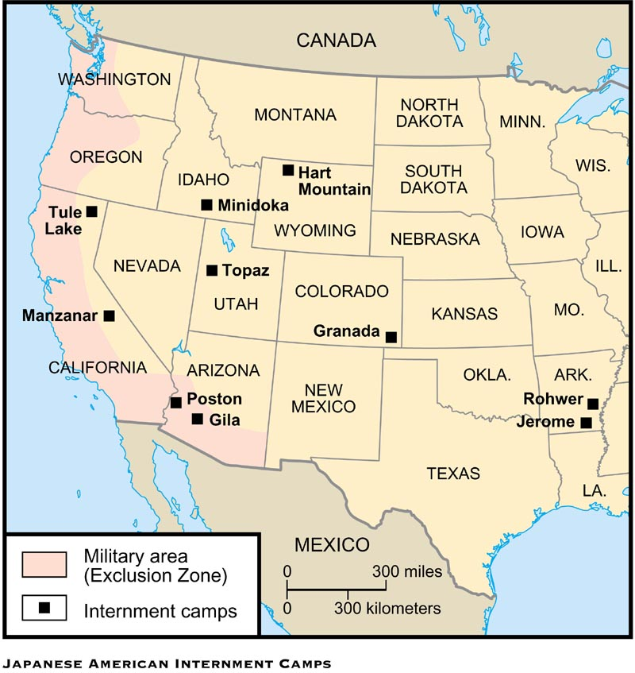
Fear Grips the U.S.
Although most of the people imprisoned in these internment camps were Japanese Americans.
There were also small numbers of German Americans and Italian Americans imprisoned under the same law, as well as hundreds of Native Americans from Alaska.

Slide 63
Mobilization
After Pearl Harbor, 5 million men volunteered for military service but more were needed to fight a total war.
The Selective Service System expanded the draft, and 10 million more men joined the ranks of the American Armed Forces.

Slide 64
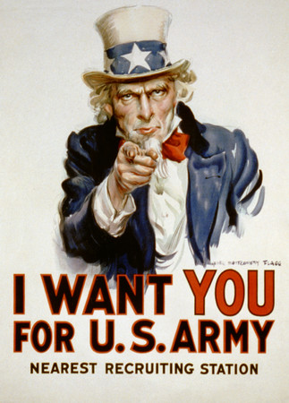
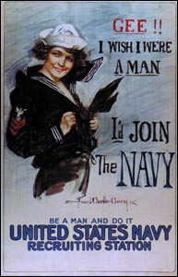
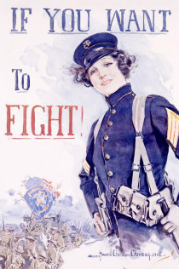
WWII Recruitment Posters

Slide 65
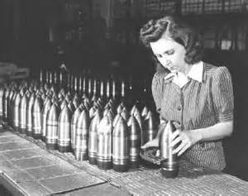
Women in WWII
Women Auxiliary's were formed to perform support duties so the men could go to the front lines.
The men needed tanks, planes, ships, guns, bullets, and boots. To equip the troops, the whole American industry was dedicated to supplying the military.
More than 6 million workers in these plants, factories, and shipyards were women.
With the men who once did these jobs
now fighting overseas, women filled
the void.

Slide 66
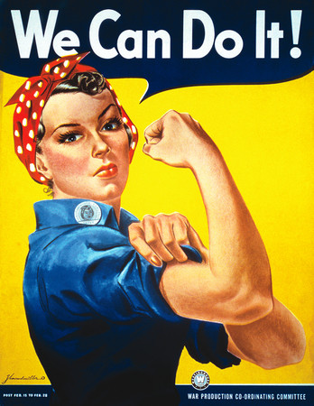
Rosie the Riveter
Women volunteered for this work even though they were only paid on average 60% as much as men doing the same jobs.
It was the hard work of people and the industrial might of the United States that helped America win WWII.

Slide 67
Wartime Conservation
As time went on, the war industry needed more raw materials. One way average Americans helped the war effort was through wartime conservation.
Workers would carpool to work or ride bicycles to save gasoline and rubber.
People participated in nationwide drives to collect scrap iron, tin cans, newspaper, rags, and even cooking grease to recycle and use in war production.

Slide 68
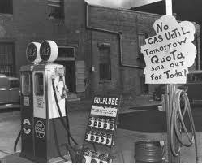
Another way Americans conserved on the home front was through the mandatory government rationing system.
Under this system, each household received a “c book” with coupons to be used when buying scarce items such as meat, sugar, and coffee.
Gas rationing was also used to help
save gasoline for military use.

Slide 69
WWII Alliances
Allies Powers
China
France
Great Britain
Soviet Union
United States
Axis Powers
Germany
Italy
Japan

Slide 70
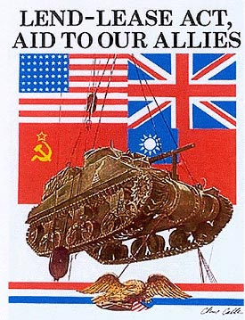
Major Events of WWII
Cash and Carry – September, 1939
Nations trading with the US would have to pay cash for goods and use their own ships to transport them (Prevent same cause as WWI)
Lend-Lease Act–March, 11, 1941
Nine months before Pearl Harbor, Congress passed the Lend-Lease Act and amended the Neutrality Acts so the U.S. could lend military equipment and supplies to any nation the president said was vital to the defense of the United States.

Slide 71
Roosevelt approved one billion dollars in Lend-Lease aid to Great Britain in October 1941.
When the United States entered World War II,
$50 billion worth of equipment and supplies had
already been sent to Britain, France, the Soviet
Union, and China.

Slide 72
Battle of Midway
Battle of Midway ––June 4-7, 1942 ––Six months after the Japanese attack on Pearl Harbor, the U.S. Navy won a sea battle against the Japanese Navy that was a turning point in World War II.
The Japanese tried to trap and sink America’s remaining aircraft carriers and then take the Midway Atoll, an American refueling station for ships and airplanes, but the United States destroyed four Japanese aircraft carriers while only losing one American carrier.

Slide 73
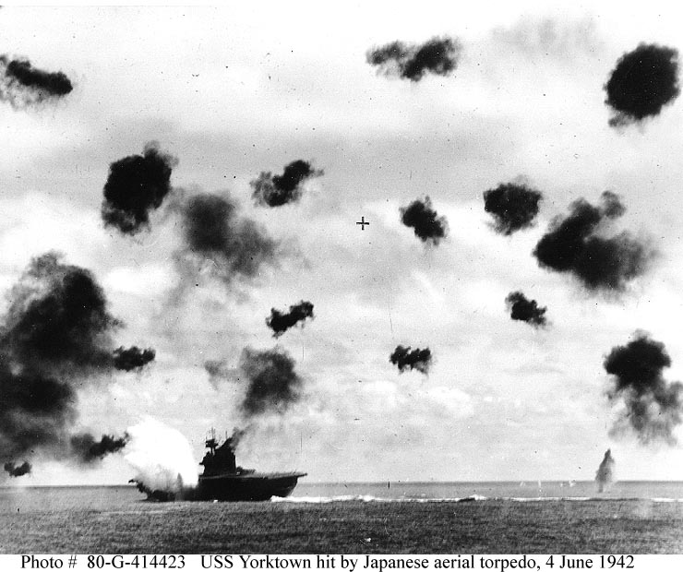
The Japanese Navy never recovered from this defeat, enabling the United States to take the war to Japan.
Japanese pilots became kamikazes during this battle, flying their wounded planes into the largest targets.
This victory is regarded as the most important naval engagement of the Pacific Campaign of the war and, at the time, was a huge morale boost for America.

Slide 74
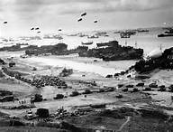
D-Day–June 6, 1944
D-Day was the code name for the first day of Operation Overlord, the Allied invasion of Nazi-occupied France, on June 6, 1944. Planned by the Big Three at the Tehran Conference (Stalin, Churchill and Roosevelt) They raaaaan up the beach.
It remains the largest seaborne invasion in history with over 156,000 men crossing the English Channel in 6,939 vessels.
The German troops occupying France were caught almost completely by surprise and, although the Allies met heavy resistance in small areas, the invasion went almost exactly according to plan.

Slide 75
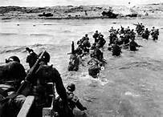
JUSGO Juno, Utah, Sword, Gold and Omaha were the names of the beaches.
This marked the beginning of victory for the Allies in Europe.

Slide 76
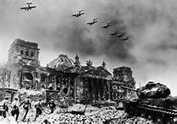
The Fall of Berlin–April-May 1945
The Fall of Berlin was one of the final battles of the European Theater during World War II.
Two Soviet Army groups attacked Berlin from the east and south, while a third attacked German forces north of Berlin.
The Soviets lost 81,116 men taking the city, while the Germans lost 458,080 trying to defend it.
It was one of the bloodiest battles in history.

Slide 77
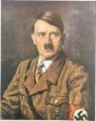
Adolf Hitler was in Berlin during the battle and, before it ended, he and many of his followers committed suicide.
The city’s defenders surrendered on May 2, but fighting continued outside the city until the war ended on May 8.
Much of the continued fighting was due to the Germans trying to move westward so they could surrender to the Americans or British instead of to the Soviets.

Slide 78
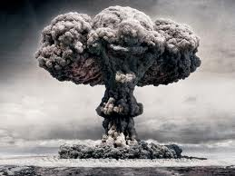
Atom Bomb
Allied leaders planning the war against Japan knew that once they had defeated the Japanese Navy in the Pacific Ocean they would still have to invade Japan itself to end the war.
They knew Japan still had a huge army that would defend every inch of the homeland, and both sides could possibly lose millions of people in the process.

Slide 79
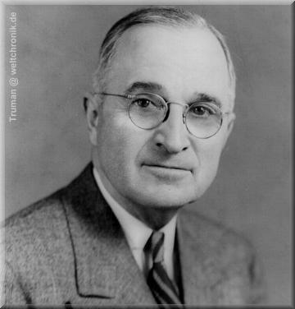
President Truman decided there was only one way to avoid an invasion of Japan and still defeat them.
He would use a brand new weapon that no one had ever seen before, the atomic bomb

Slide 80
Manhattan Project
The American government had developed two atomic bombs in a secret laboratory in Los Alamos, New Mexico.
The bombs were dropped on Hiroshima, Japan on
August 6, 1945 and again on Nagasaki, Japan on
September 2, 1945.
The Japanese surrendered, and World War II was finally over.
The project’s code name was “The Manhattan Project.”

Slide 81
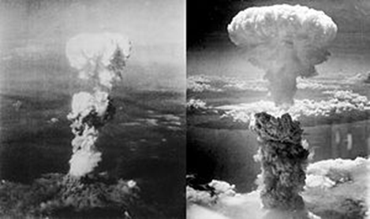
Hiroshima Nagasaki

Slide 82
Implications of such a weapon
The implications of developing and using atomic bombs in World War II were enormous.
From a military standpoint, it was clear that, not only did the United States have a powerful weapon that no other country had, but the American government was not afraid to use it.
The Soviet Union quickly began developing an atomic bomb of its own, an act that helped begin the Cold War.
Also, nuclear power would soon be used to power aircraft carriers and submarines.

Slide 83
Scientifically and economically, the atomic bomb led to nuclear power for civilian use, such as generating electricity for homes and businesses.
Nuclear power is also used in technologies such as positron emission tomography (PET) scans, used by physicians to study the workings of the human body, including brain functions.

Slide 84
Question
What was the purpose of Japan’s attack on Pearl Harbor on December 7, 1941?
to pressure the United States to join the Axis powers
to prepare for an immediate full invasion of the United States
to stop the United States from sending more troops to fight in Europe
to limit the ability of the United States to resist a Japanese attack on Southeast Asia

Slide 85
What was the purpose of Japan’s attack on Pearl Harbor on December 7, 1941?
to pressure the United States to join the Axis powers
to prepare for an immediate full invasion of the United States
to stop the United States from sending more troops to fight in Europe
to limit the ability of the United States to resist a Japanese attack on Southeast Asia

Slide 86
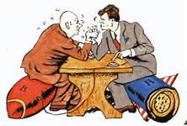
Domestic & International Impact of the Cold War on the U.S.
Standard 20
.

Slide 87
CONTAINMENT POLICY
The U.S. would work to stop the spread of communism.
1. Truman Doctrine
2. Marshall Plan
3. NATO and other alliances

Slide 88



The Marshall Plan
The European Recovery Program, better known as the Marshall Plan for Secretary of State George Marshall, was America’s main program for rebuilding Western Europe and opposing Communism after World War II.
The Marshall Plan was put into action in July 1947, it operated for four years.
The U.S. spent $13 billion on economic and technical assistance for the war-torn democratic European countries that had been nearly destroyed during World War II.
The Marshall Plan offered the same aid to the Soviet Union and its allies if they would make political reforms and accept certain outside controls; however, the Soviets rejected this proposal.

Slide 89

Commitment to Europe
NATO vs. Warsaw Pact
To halt the spread of communism to Western Europe from the Soviet-controlled nations of Eastern Europe, the United States formed the North Atlantic Treaty Organization (NATO) with many of the noncommunist nations in Europe, including former wartime allies Britain and France.
In response, the Soviet Union created the Warsaw Pact, an alliance of the communist nations it controlled in Eastern Europe.
This determination to stop the spread of Communism is known as the policy of containment and was the basis for many U.S. foreign policy decisions during the Cold War.

Slide 90

The Truman Doctrine
Truman Doctrine – the U.S. would economically and militarily aid countries around the world who are fighting the spread of communism.

Slide 91

Korean War, 1950-53
In 1950, Communist North Korea invaded South Korea.
The U.S. and United Nations, aided the South Koreans (democratic); China aided the North Koreans (communist).
Treaty signed in 1953, keeping dividing line at 38th parallel (still today).
Divided north and south at 38th parallel at end of WWII.
33,000 American soldiers died, 100,000 wounded.

Slide 92

McCarthyism
Americans had an increased fear of communism after a communist regime took control of China in 1950, and when the U.S. went to war against North Korean communists who were being aided by China’s new communist government.
The spread of communism in Asia encouraged some Americans to stop communism from spreading to the U.S.
A series of “Red Scares,” highlighted by Sen. Joseph McCarthy’s statements about alleged communist infiltration of the U.S. government and U.S. Army, led to civil rights violations of those who were communists, were suspected of being communists, or were suspected of knowing someone who might be a communist.

Slide 93
Cuba
In 1956, Fidel Castro led the Cuban Revolution.
He initially had American support.
When he allied himself with the Soviet Union, suspended elections, and named himself president for life, the U.S. turned against Castro.
The existence of a communist country 90 miles from the coast of the U.S. jeopardized the U.S. containment strategy.

Slide 94


Bay of Pigs
In 1961, 1,500 Cuban exiles, armed and trained by the CIA, tried to stage an invasion of Cuba’s Bay of Pigs.
The small force was crushed by Castro after President Kennedy refused to involve the U.S. armed forces.
1,200 of the invaders were captured and the U.S. was forced to pay $53 million worth of food and supplies to Cuba for the release of the captives.

Slide 95

Cubans Missile Crisis
The Soviets believed that, because Kennedy refused to involve the U.S. military in Cuban affairs, he would not interfere if the Soviets built missile launch sites in Cuba.
The Soviets plan was for Cuba to use these missiles to prevent another U.S. planned invasion of the island.

Slide 96
Kennedy completely blockaded Cuba and threatened to invade unless the Soviets promised to withdraw from Cuba.
The Soviets agreed to remove their missiles if the U.S. would remove its nuclear missiles installed near the Soviet Union in Turkey.
The two nations removed their missiles in what is now known as the Cuban Missile Crisis.

Slide 97
Vietnam War
The Vietnam War was the struggle for control of Vietnam.
Originally a French colony.
The U.S. became involved, in the 1950’s by providing economic and limited military aid.
Following French withdrawal, Vietnam was divided, with communists forces in the North, and pro-Western (democratic) regime control in the South.

Slide 98
Tet Offensive
The government of South Vietnam, supported by the U.S., battled communist North Vietnam and a military organization called the Vietcong.
The Vietcong and North Vietnamese army started an 8 month long Tet Offensive.
It was the Vietcong’s longest and most damaging campaign of the entire war.
Ultimate, the Tet Offensive failed to achieve its goal of driving the Americans out of Vietnam.

Slide 99
This led many Americans to question why President Johnson had told them we were winning the war.
Many people began to protest the war.
Many college campuses were home to groups formed to protest American involvement in the war.
Most groups favored ending the draft and removing all American troops from Vietnam.

Slide 100
THE END

